Slide 2
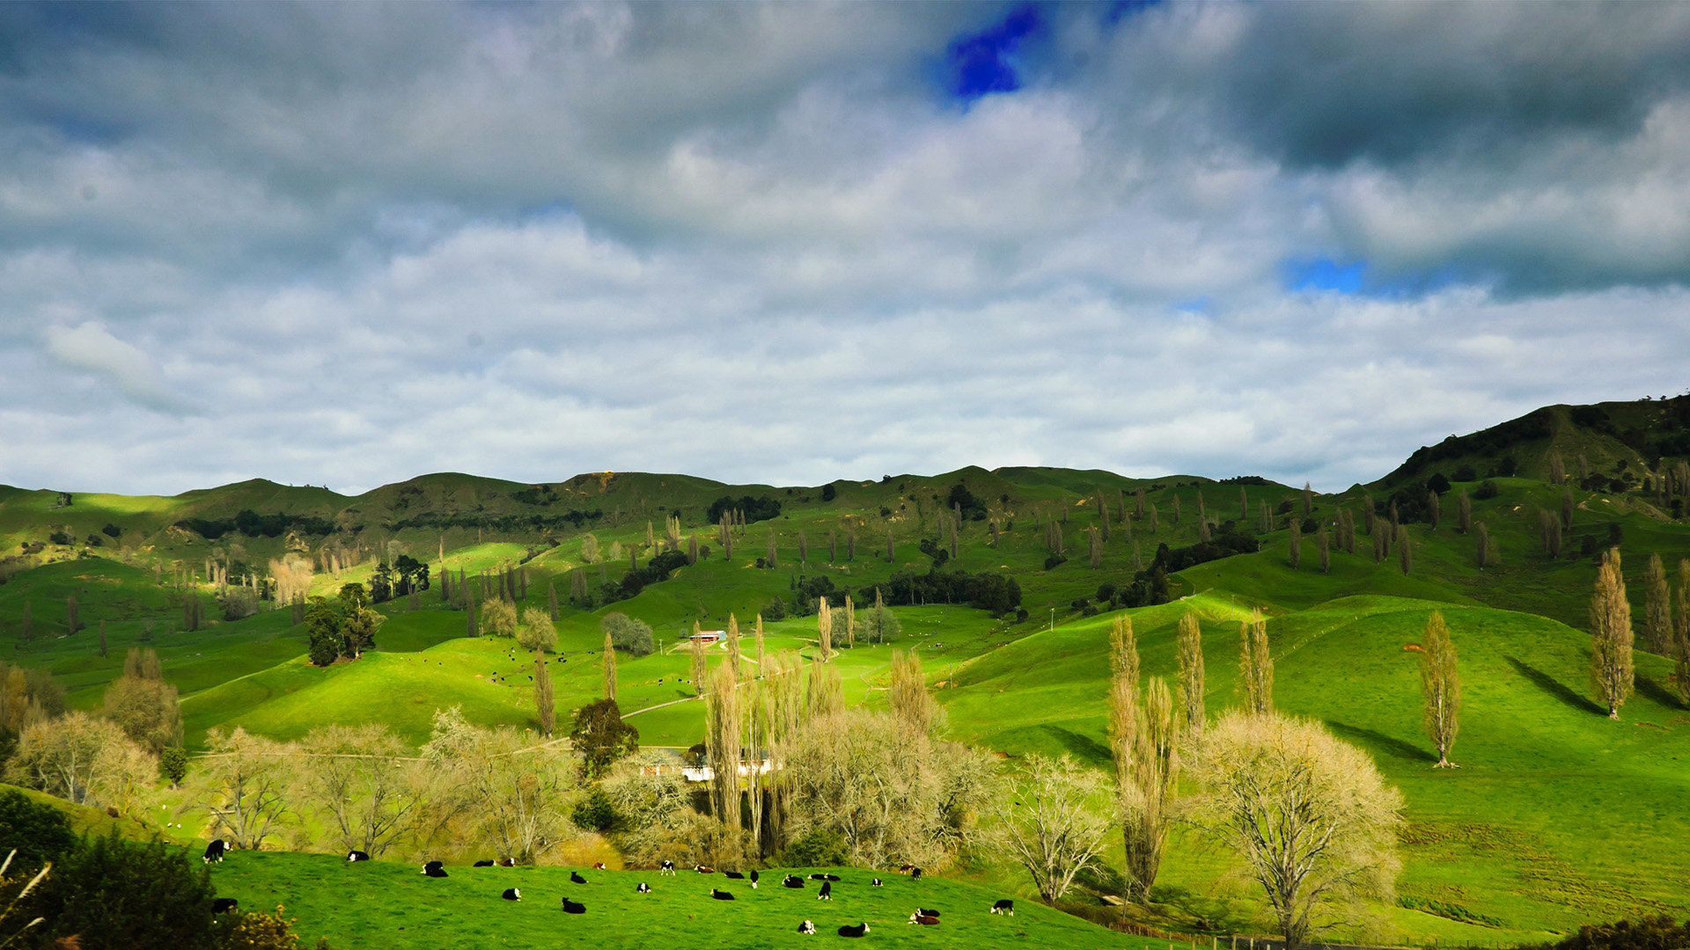
WAIKATO
REGIONAL COUNCIL
Lake Taupo Zone Committee
02 August 2019
Waikato region: - Climate change in context

Slide 3
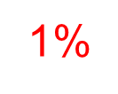
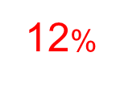
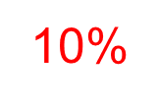
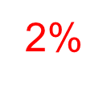
National and regional emissions
Waikato regional emissions – 2015 / 2016 year by sector in RED
17.2% | GHG emissions
10% | Land area
9.6% | Population
8.4% | GDP
75%
Notes:
Waikato makes up:
8.4% of NZ GDP
9.6% of NZ Population
9.1% of NZ exports
26.2% of NZ dairy cows
25.3% of NZ milk solids production
30.7% of NZ dairy herds
25.5% of NZ ha in dairy production
14.8% of NZ forestry and logging GDP
29.1% of NZ dairy farming GDP
13.3% of NZ dairy manufacturing GDP
13.3% of NZ dairy GDP (farming and manufacturing combined)
All from Infometrics
In the year to June 2016, activities within Waikato Region’s boundaries generated 13.8 million tonnes of carbon dioxide equivalent (tonnes CO₂e). When forestry is included, the total net emissions are reduced to 8.2 million tonnes CO₂e. This compares with national gross emissions of 80.2 million tonnes CO₂e The Waikato region’s contribution to gross national emissions in 2016 was therefore 17.2 percent, a relative reduction of 18 percent from 2002 levels.
Agricultural activities in the region generate the largest amount of the gross emissions (75.5 percent), followed by transportation (11.7 percent) and stationary energy (9.7 percent). Forestry removed a net volume of 5.6 million tonnes CO₂-e or 41 percent of the total gross emissions.
http://www.mfe.govt.nz/climate-change/state-of-our-atmosphere-and-climate/new-zealands-greenhouse-gas-inventory
Compared to 2002 – Waikato region was 21% of national emissions profile (reduced 18% - expansion of Ag in other regions and close down of 2 Rankine units in Huntly (coal to gas))

Slide 4
Climate change projections and impacts
Varies with season and spatially over time (2014, IPCC, AR5 CMIP5 data)
Less frosts in the north of the region
More intensive rain events in the south and west of the region - higher flows to west coast harbours – lake Taupō and Waipa sub catchments
Less wind average but higher winds speeds during storm events
Similar average rainfall in the north-eastern part of the region – shift in delivery with late summer rainfall events and increased droughts
Notes:
The IPCC's Fifth Assessment Report (AR5) relies heavily on the Coupled Model Intercomparison Project, Phase 5 (CMIP5), a collaborative climate modelling process coordinated by the World Climate Research Programme (WCRP).

Slide 5
Government Directions
Regional development
1Billion trees
Shift in Transport priorities
Mode shift to rail, public transport, walking
New zero emissions target for 2050
Establishment of an Interim Climate Change Committee
National Climate Change Risk Assessment Framework
National Adaptation Plan
Roadmap of 5 yearly carbon budgets
ETS review

Slide 6
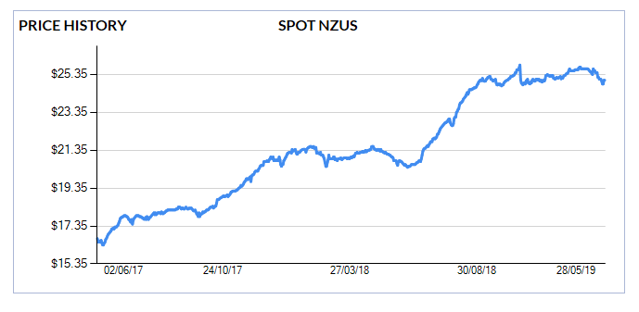
ETS – NZ Emission Unit price
30 July 2019 $ 23.50

Slide 7
Climate Change Responses: Mitigation or Adaptation or both?
“Climate mitigation is about carbon emissions, climate adaptation is about water”
14 January 2016

Slide 8
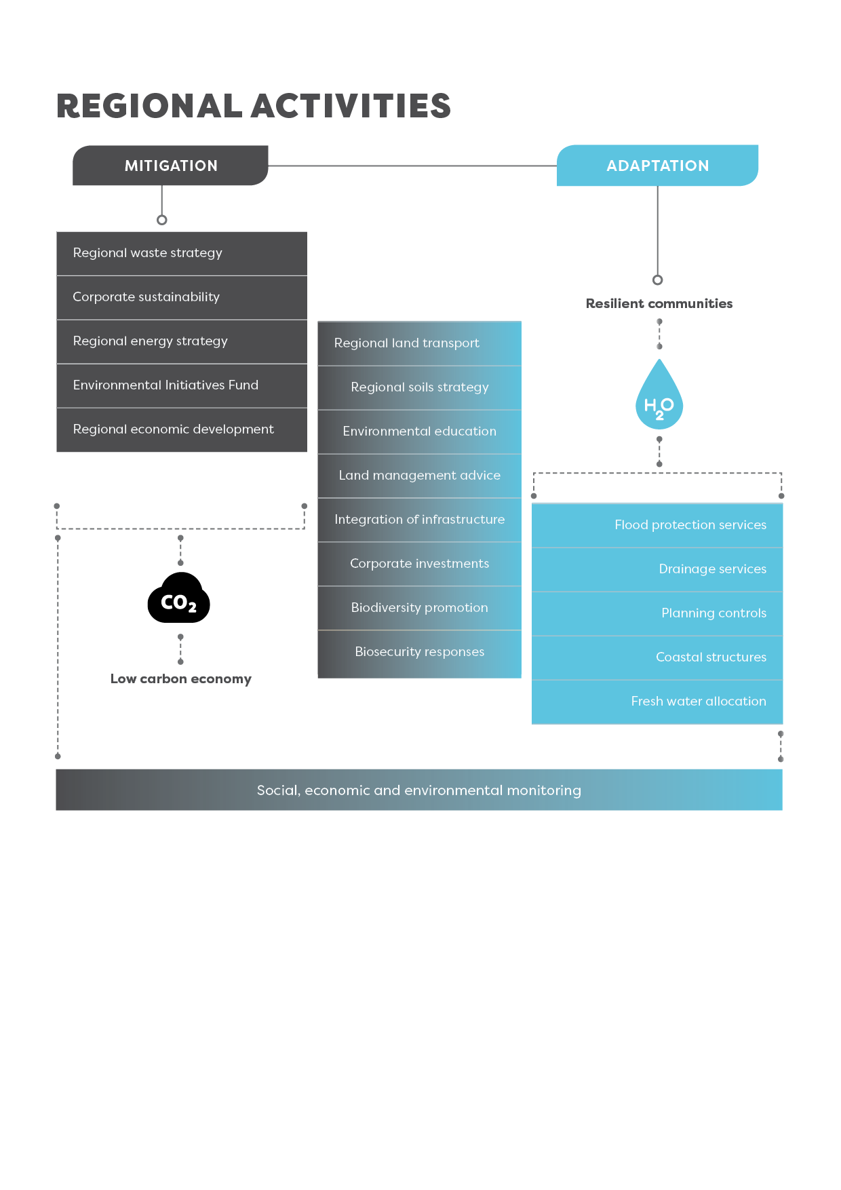

Slide 9
Adaptation as a transition – starting now - Forever

Slide 10
Water
Too much water – floods – land use change
Not enough water – water allocation increased storage
Sea level rise / Coastal & groundwater
Manage for extremes

Slide 11
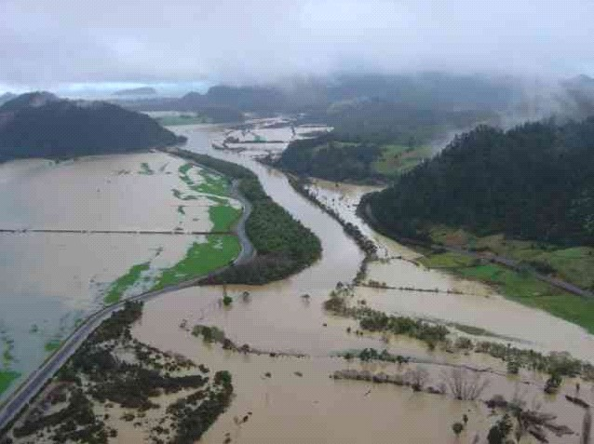
Tairua River 2002

Slide 12
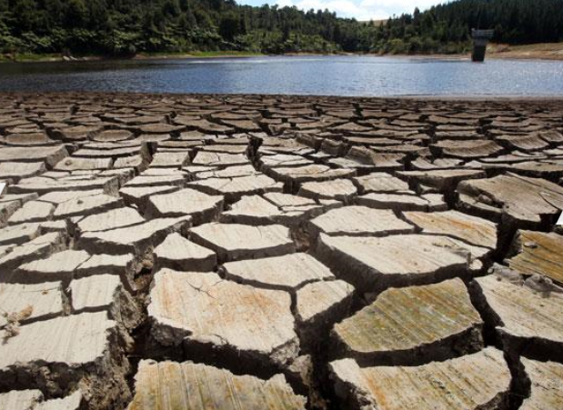
Morrinsville, March 2013

Slide 13
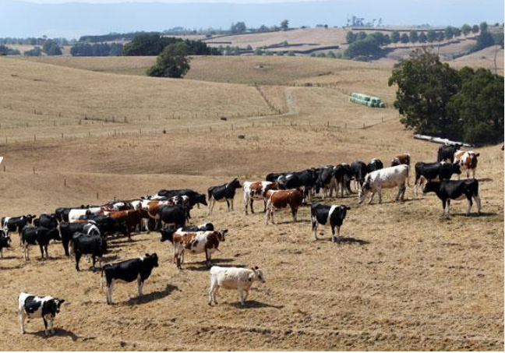
Scotsman’s Valley, Waikato March 2013

Slide 14
Thames Coast 05 January 2018

Slide 15
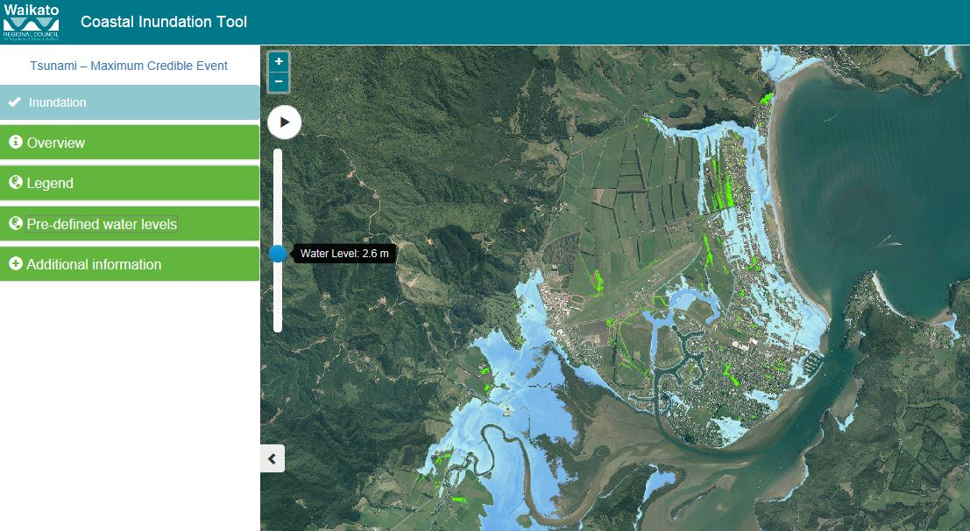
www.waikatoregion.govt.nz/coastal-inundation-tool/
Whitianga: Highest storm tide (Current) + locked – in 0.4m SLR
Notes:
Released live 02 March 2016
Purpose is to identify low lying coastal areas
Inundation modelling at 0.2 m increments based on LiDAR
Interactive Web Based mapping
User able to map inundation extent of water level elevations
Additional information to provide indicative scenarios for:
Tides - Storm tides & Sea Level Rise
Provide the public with a ‘heads up’ in identifying possible inundation issues in the future.
www.waikatoregion.govt.nz/coastal-inundation-tool/

Slide 16
Carbon sequestration: Right tree, Right place, Right purpose
Focus on carbon sequestration may favour and direct afforestation towards P. radiata
Would not be suitable in all applications
Some land would suit other species or native protection planting
Regeneration of natives may be an even better option
Enhanced property scale riparian plantings would deliver co-benefits:
Enhanced water quality
Biodiversity
Reduced bank erosion
Aquatic habitat protection,
Flood attenuation and
Carbon sequestration

Slide 17
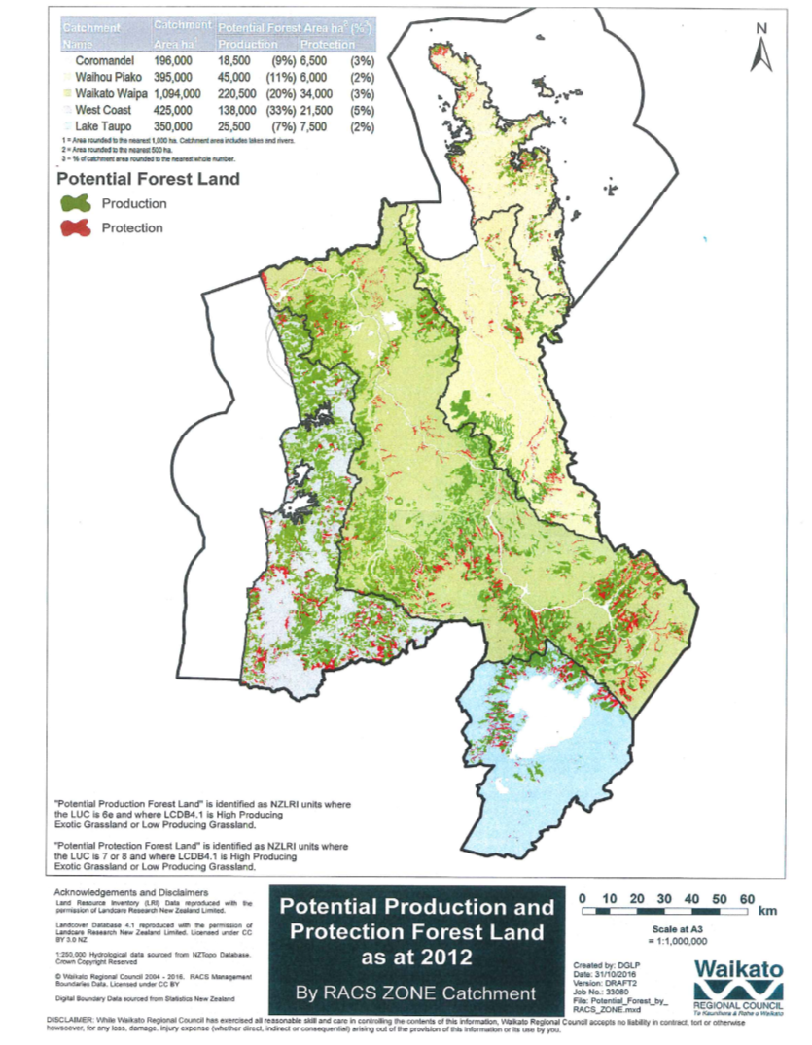
Opportunities
Waikato region has 523,000 ha marginal land* in pasture ₍₂₀₁₂₎
Current use is mostly dry stock and dairy support
Could be used for mix of production (447,00ha) forestry and protection (76,000ha) plantings
65,000ha only of ‘commercial’ land
Co-benefits for water quality and estuarine habitat
* LUC Classes VIe, VII & VIII

Slide 18
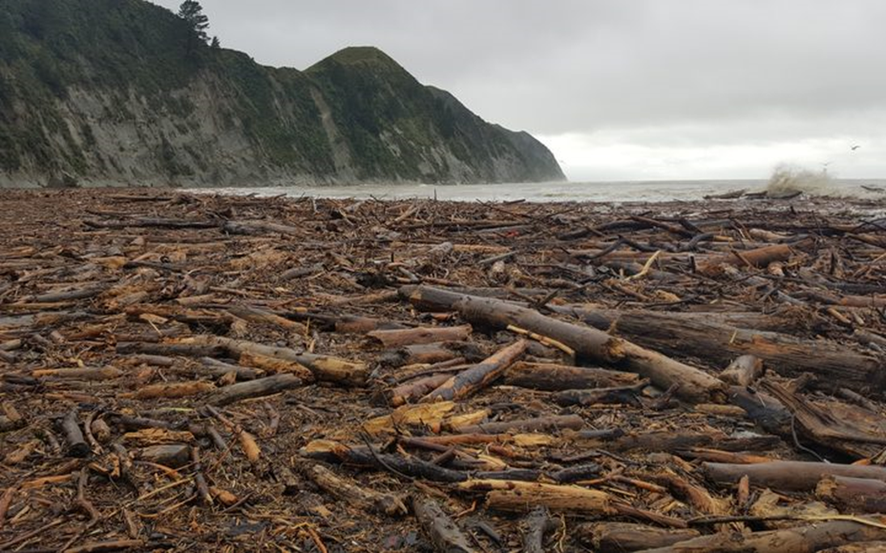
Tolaga Bay 05 June 2018

Slide 19
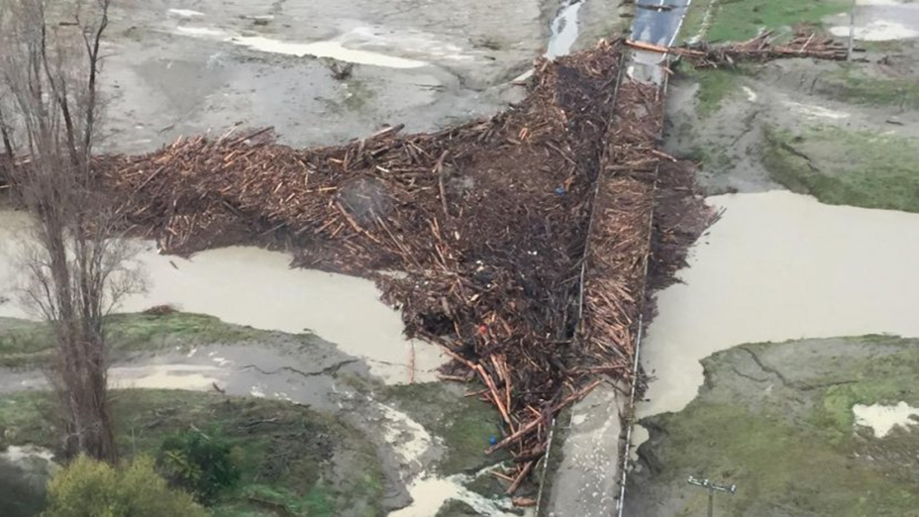
Tolaga Bay 05 June 2018
Notes:
King Tide examples

Slide 20
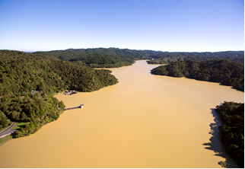
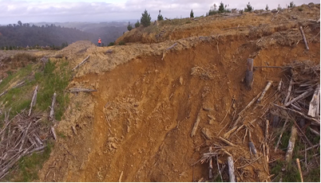
Hunua Ranges January 2017

Slide 21
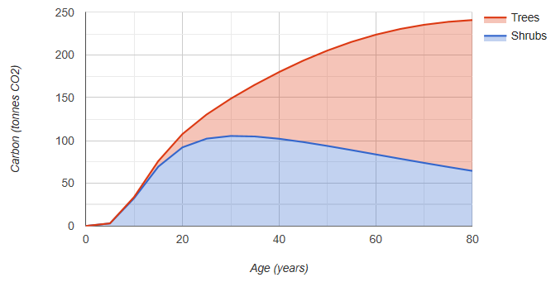
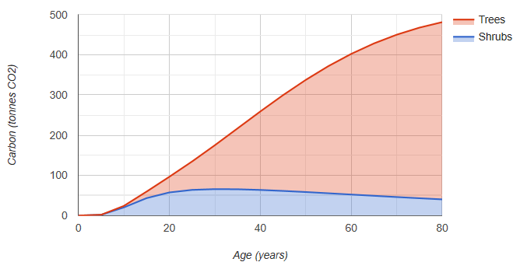
Waikato region –carbon sequestration opportunities using natives
80% shrubs, 20% trees, 75% survival
1ha, 1000 stems: 205.4 tonnes CO₂ after 50 years
50% shrubs, 50% trees, 75% survival
1ha, 1000 stems: 337.8 tonnes CO₂ after 50 years
Notes:
100% trees @75% survival = 558.4 tonnes CO₂ after 50 years

Slide 22
Way Forward
Can’t do it alone – Work with Iwi partners, stakeholders, businesses and communities
Understand local climate projections and impacts
Understand local greenhouse gas emissions Establish the science base
Measure corporate emissions
Understand exposure of current activities to climate impacts
Understand local issues – seek local solutions
Factor climate projections into all long term decision-making
Reduce exposure to carbon e.g. through procurements /contracts
Embed low carbon and climate awareness into corporate culture – policies, recruitment, systems, templates, training, rewards.
Review and amend external policies, rules and design / operation of infrastructure

Slide 23
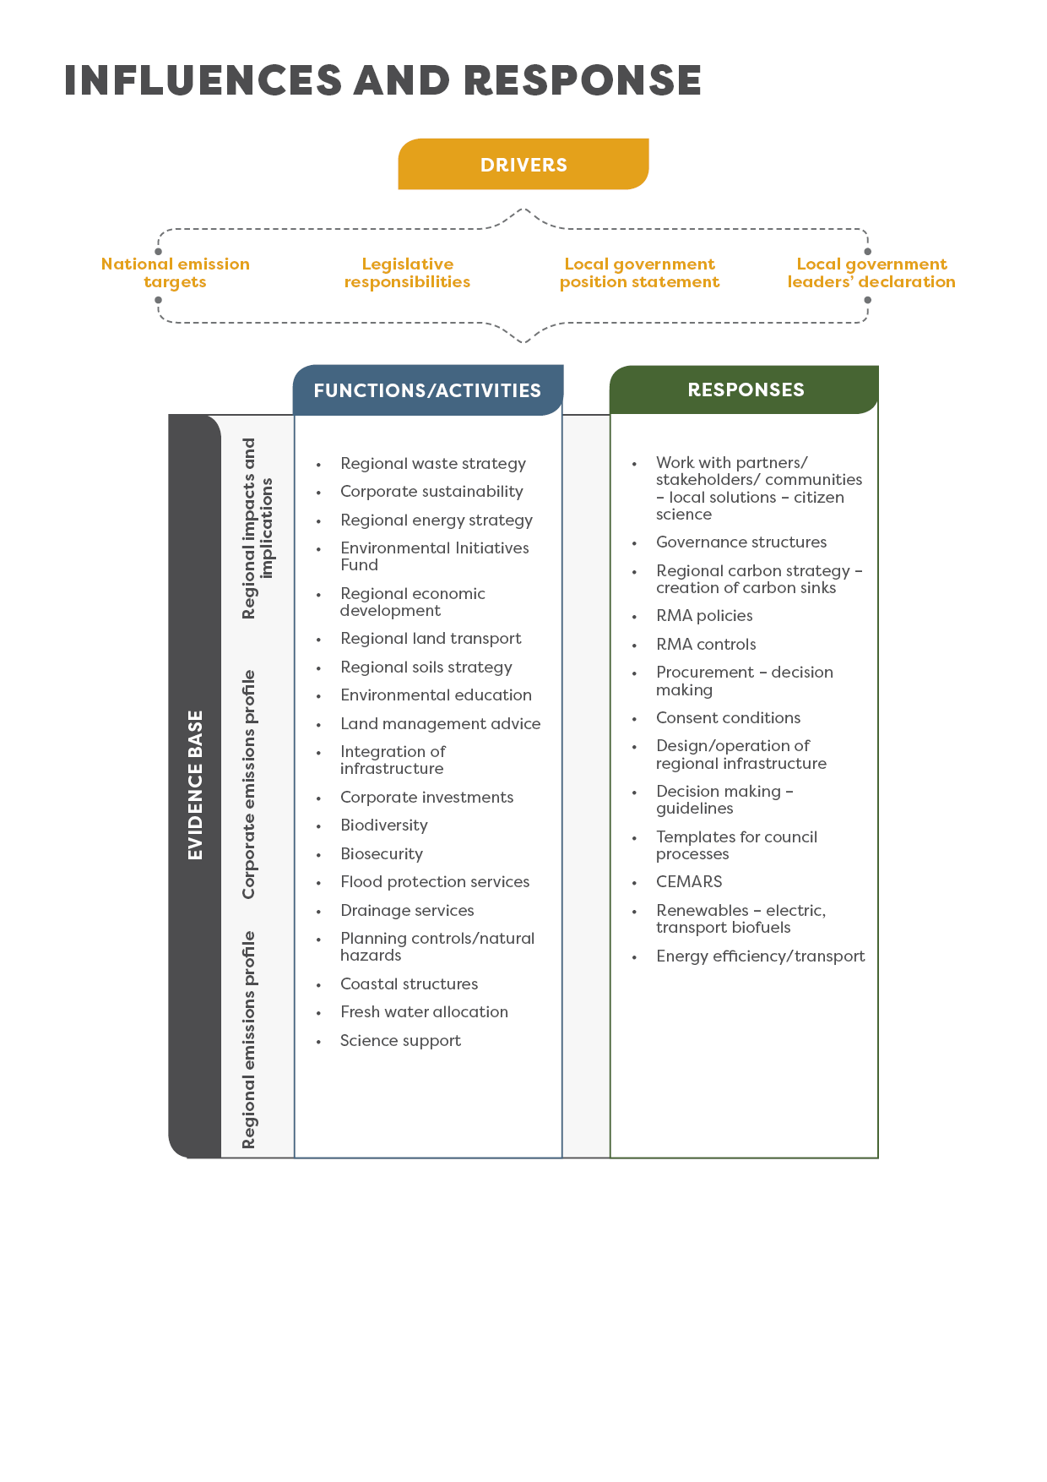
Influences and Responses
Bringing it all together in the WRC context

Slide 24
Thank you
Ngā mihi
Notes:
100% trees @75% survival = 558.4 tonnes CO2 after 50 years

